Slide 1
AIML PROJECT
Obesity Team Members
Anmol Singla | 2210990129
Ansh Khurana | 2210990136
Rhythm | 2210990722
Rohan Kapoor | 2210990738

Slide 2
CONTENT
Problem Statement
Objective
Tools Used
Data Summary
Exploratory Data Analysis
Challenges
Recommendations
Conclusions
Q & A

Slide 3
PROBLEM STATEMENT
Developing a precise predictive model for classifying individuals into various obesity levels based on lifestyle factors like age, gender, diet, physical activity, technology usage, and transportation. This model aims to enable early identification of at-risk individuals and provide insights for personalized intervention strategies, ultimately contributing to effective public health initiatives combating obesity and promoting healthier lifestyles.

Slide 4
OBJECTIVE
The objective of the project is to develop a predictive model for estimating obesity levels based on lifestyle factors. This involves conducting exploratory data analysis (EDA), data preprocessing, and cleaning on a comprehensive dataset containing information such as age, gender, dietary habits, physical activity levels, technology usage, and transportation modes.
Using Python libraries including Pandas, NumPy, and Scikit-learn, the project aims to preprocess the data, handle missing values, and ensure data quality. Additionally, advanced data visualization techniques using libraries like Plotly will be applied to gain meaningful insights from the dataset.
By visualizing key features such as lifestyle factors, demographic information, and health indicators, the project seeks to uncover patterns, trends, and relationships within the data that can inform the development of a predictive model for classifying individuals into different obesity levels. This model will facilitate early identification of at-risk individuals and provide insights for personalized intervention strategies, contributing to public health initiatives aimed at combating obesity and promoting healthier lifestyles.

Slide 5
Tools Used
Jupyter Notebook is used as IDE.
Numpy is used for numerical computation of the dataset.
Pandas is used for exploratory data analysis.
Matplot and Seaborn are used for visualization of the dataset.
GitHub is used as the version control system.

Slide 6

DATA SUMMARY
Categorical Data
Gender
CALC
SCC
Smoke
Family History
CAEC
Mtrans
Obesity Type
Numerical Data
Age
Height
Weight
FCVC
NCP
CH2O
FAF
TUE

Slide 7
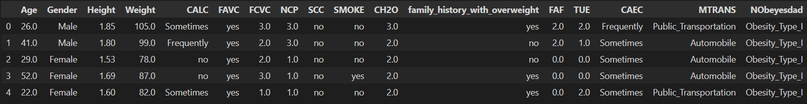
DATA SUMMARY
This is the dataset. The first five rows of the dataset are depicted below.

Slide 8
FEATURES
Age | CH2O
Gender | Family History
Height | FAF
Weight | TUE
CALC | CAEC
FAVC | MTRANS
FCVC | Obesity Type
NLP | Smoke
SCC

Slide 9
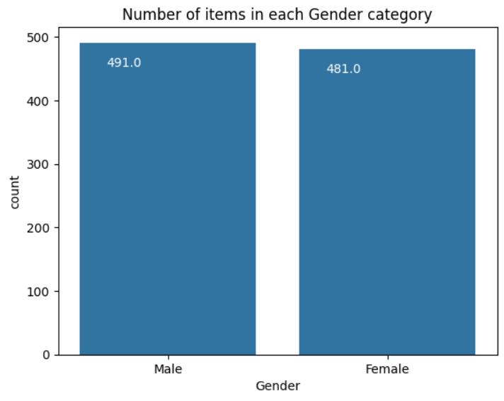
Number of items in each gender category
The graph displays the number of items in each gender category, with a range of items from 0 to 500.
The two gender categories are Male and Female.
The Male category has a higher count than the Female category for all data points.
The highest count is for the Male category, with 491 items.
The count for the Female category is 481.

Slide 10
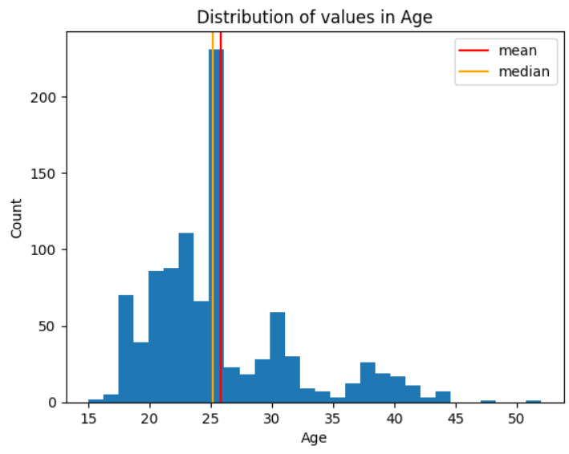
Distribution of values in age
The 'Count' values (200, 150, 100, 50) represent the frequency or number of occurrences of certain data points.
The 'Distribution of values in Age' (0, 15, 20, 25, 30…) are age categories with their corresponding counts.
'mean' and 'median' are statistical measures.

Slide 11
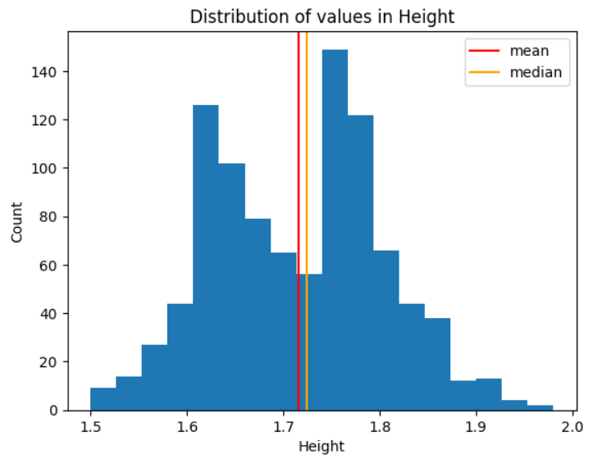
Distribution of values in height
The distribution of heights follows a right-skewed pattern with a long tail on the right side.
The median is slightly higher than the mean.
The data has a range of 180 units (from 1.5 to 2.0), with a majority of the values concentrated around 1.6 to 1.8.

Slide 12
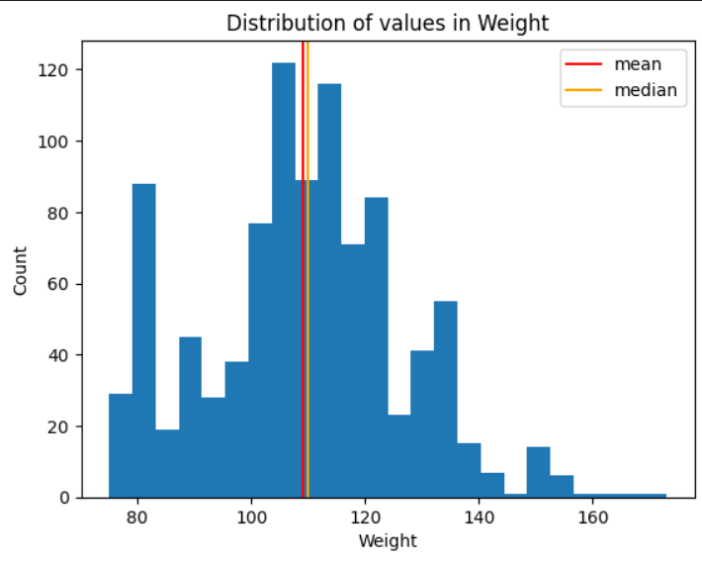
Distribution of values in weight
The median lies between 100 and 120.
The weight distribution is slightly right-skewed, with more values towards the lower end but a few extremely high values.

Slide 13
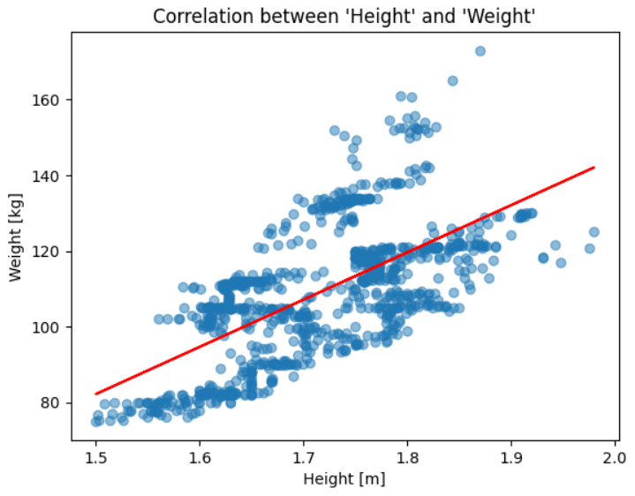
Correlation between height and weight
There seems to be a positive correlation between height and weight, meaning taller individuals tend to weigh more.
The correlation increases by 0.1 for every 20 cm increase in height.
The weight ranges from 80 kg to 160 kg, suggesting a significant variation.
The correlation values range from 1.5 to 2.0, indicating a strong relationship between height and weight.

Slide 14
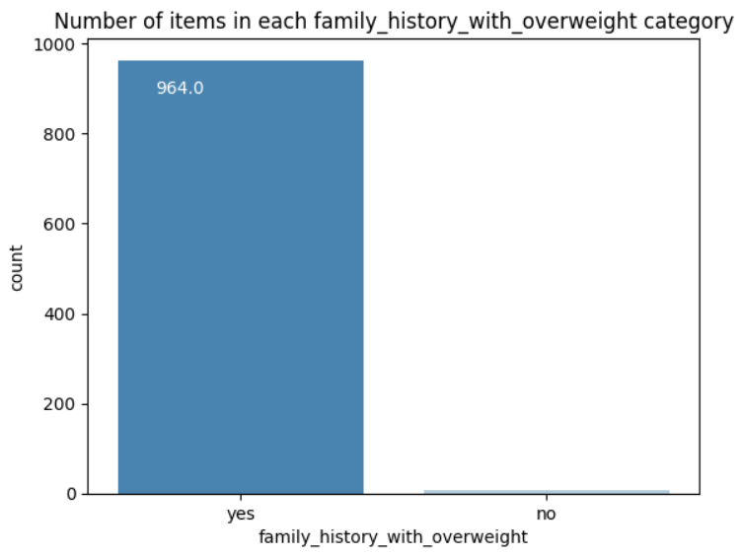
Number of items in family history column
A total of 964 individuals have a family history of overweight, as indicated by the sum of the category counts.
The data is categorized as yes or no.

Slide 15
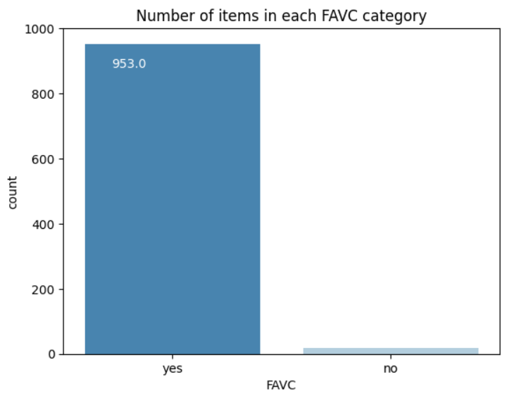
Number of items in FAVC column
A There are two categories in the FAVC (Freeze All Viable Cells) system.
The first category has approximately 953 items.
The second category has a significantly lower number of items compared to the first category.

Slide 16
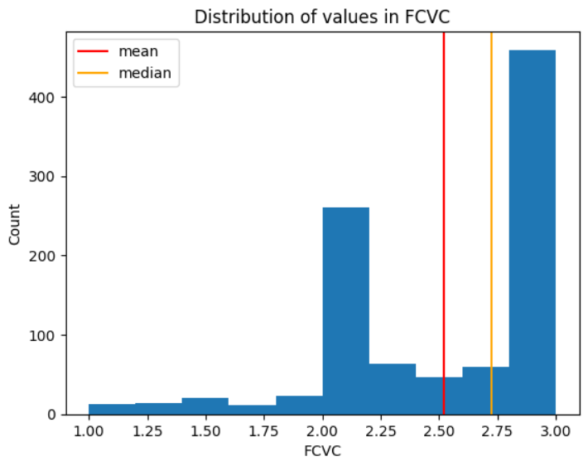
Distribution of values in FCVC
The mean and median of the FCVC values are not explicitly provided in the graph, but they appear to be around 2.50 and 2.75, given the distribution of the data points.
The distribution of values is not uniform, as there are more data points towards the higher end of the FCVC scale and fewer towards the lower end.

Slide 17
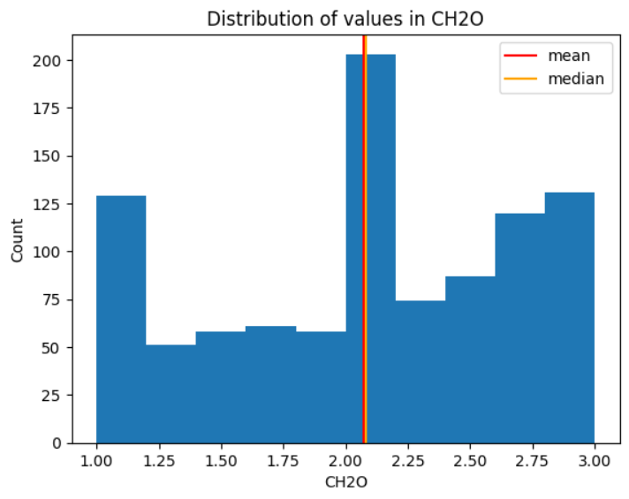
Distribution of values in CH2O
The data represents the count and distribution of values in CH2O, which seems to be a chemical compound. The distribution shows a range from 0 to 3.00 with varying frequency.
Both the mean and median lie between 2.00 and 2.25, very close to each other.

Slide 18
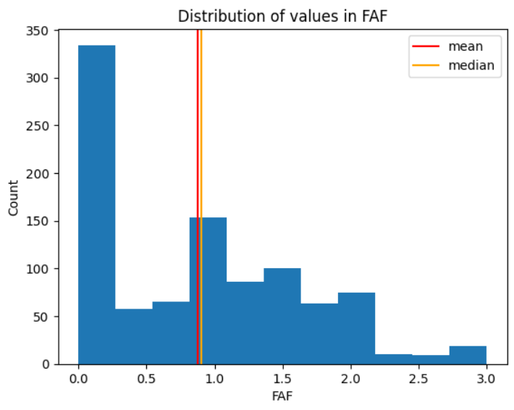
Distribution of values in FAF
The distribution of FAF values has a mean of approximately 0.75 and a median of 1, indicating a slight positive skew.

Slide 19
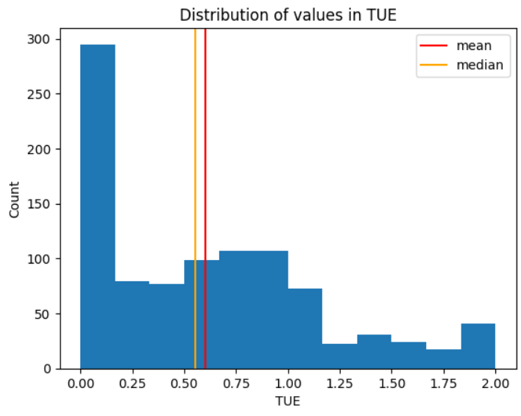
Distribution of values in TUE
The values in TUE are slightly skewed to the left, as the median is greater than the mean.
The minimum value of TUE is 0, and the maximum value is 2.0. This indicates that the range of TUE is 2.0.

Slide 20
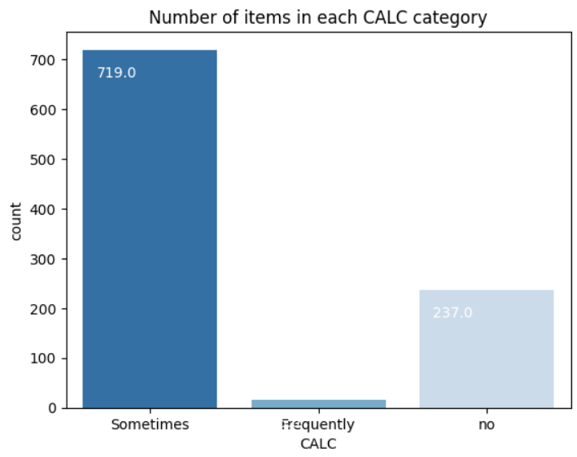
Number of items in each CALC category
There are 719.0 items in the first "CALC" category, which is the highest among all categories.
The second category has no items, as indicated by the value "0.“
The terms "Sometimes" and "Frequently" are mentioned.

Slide 21
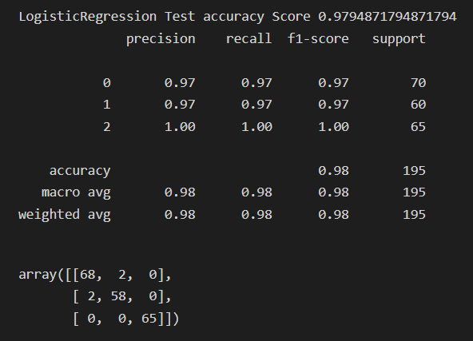
ML MODEL 1 : LOGISTIC REGRESSION
Logistic regression is a statistical method used to model the relationship between one or more independent variables and a binary outcome, predicting the probability of occurrence of an event.
It is performed to classify observations into one of two or more discrete categories based on input features.
Logistic regression tells us about the likelihood of an event occurring based on the values of the independent variables and provides probabilities associated with each class label.

Slide 22
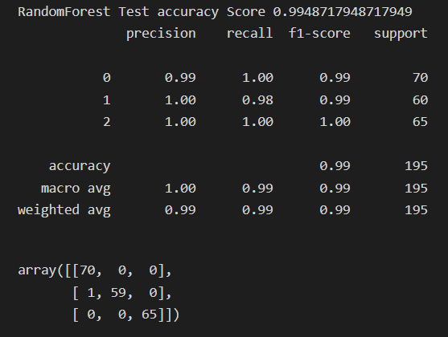
ML MODEL 2 : RANDOM FOREST CLASSIFIER
Random Forest Classifier is an ensemble learning method that constructs multiple decision trees during training and outputs the mode of the classes (classification) or mean prediction (regression) of the individual trees.
It is performed to improve the predictive accuracy and control overfitting by averaging the predictions of multiple decision trees.
It tells us about the importance of different features in predicting the target variable and provides insights into the relationships between features and the target.

Slide 23
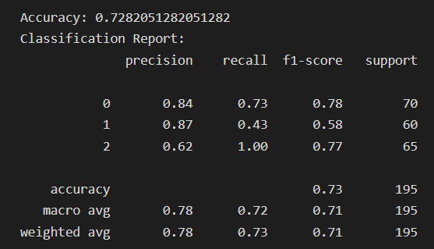
ML MODEL 3 : SUPPORT VECTOR MACHINE
SVM (Support Vector Machine) is a supervised machine learning algorithm used for classification and regression tasks.
It is performed to find the hyperplane that best separates different classes in the feature space.
SVM tells us about the data by identifying the optimal decision boundary that maximizes the margin between classes, providing effective classification and generalization performance.

Slide 24
ML MODEL 4 : DECISION TREE
Decision Tree is a predictive modeling technique that recursively splits the dataset into subsets based on the value of input features to make decisions.
Performed for: Classification and regression tasks, as it's versatile and interpretable.
Tells us about the data: Reveals the most significant variables, their relationships, and the decision-making process, aiding in understanding and predicting outcomes.

Slide 25
Challenges
The following challenges were faced:
Selecting the most suitable type of graph to effectively represent the data.
Adding informative labels and annotations to make the graphs more understandable.
Managing large volumes of data can lead to performance issues or overcrowded graphs.
Identifying the most relevant features from a large pool of variables can be challenging.
Ensuring fairness, accountability, and transparency in model development and deployment is essential to mitigate biases and potential harm.

Slide 26
Conclusions

Slide 27
Q & A

